Slide 1
UML
CIS 200
Rafi Almhana

Slide 2
UML
Unified Modeling Language
9 different diagrams for describing a program
Software Engineer
UML is the way to communicate the software to be developed.

Slide 3
Classes
What is a class?
A class is a group of things that have common state and behavior
You can think of a class as a blueprint for an object
Examples:
Class Car
Object Dodge Charger
Object Ford Fusion

Slide 4
UML Class Diagrams
Attributes
These can be thought of as the data members of a class
They describe static characteristics about an object
Name
Age
Height
Weight

Slide 5
UML Class Diagrams
Behaviors
They describe what objects of the class type do
These can be thought of as the member functions of the class
int getAge( )
string getName( )
void setName(string nm)

Slide 6
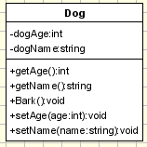
UML Class Diagrams
Example: Dog Class
Class Dog
{
private:
int dogAge;
string dogName;
public:
int getAge();
void Bark();
string getName();
void setAge(int age);
void setName(string name);
};

Slide 7

UML Class Diagrams
First compartment is the class name
Next are the data members
Then, the member functions

Slide 8

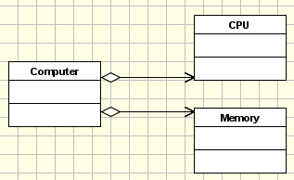

UML Class Diagrams
Some Relationships
Generalization:
Dog is a type of Animal
Aggregation
Defines an “owns a” relation
Association
Defines a “has a” relation
Window has a cursor, but it doesn’t maintain possession of the cursor forever, but only temporarily

Slide 9
Use Cases
Use case is a set of textual scenarios that describe the proposed solution to a problem.
Not object-oriented, but an important part of the problem analysis
Main success scenario (“happy path”) describes when everything goes smoothly
Usually multiple scenarios per use case
Scenarios are written from the perspective of a user of the system.
Focus is on identifying responsibilities of the system to satisfy users needs
What to do, not how to do it
Focus on interactions between user and system
User interface to system is explored during design
Nouns in use case become potential objects in solution

Slide 10
Use Case Diagrams
Use case diagrams describe what a system does from the standpoint of an external observer.
The emphasis is on what a system does rather than how.
Use case diagrams are closely connected to scenarios.
A scenario is an example of what happens when someone interacts with the system. Here is a scenario for a medical clinic.

Slide 11
Medical Scenario
"A patient calls the clinic to make an appointment for a yearly checkup. The receptionist finds the nearest empty time slot in the appointment book and schedules the appointment for that time slot. "

Slide 12

Use Case Medical Scenario
A use case is a summary of scenarios for a single task or goal.
An actor is who or what initiates the events involved in that task.
Actors are simply roles that people or objects play.
The picture below is a Make Appointment use case for the medical clinic.
The actor is a Patient. The connection between actor and use case is a communication association (or communication for short).

Slide 13
Shapes
Actors are stick figures.
Use cases are ovals.
Communications are lines that link actors to use cases.
A use case diagram is a collection of actors, use cases, and their communications.

Slide 14
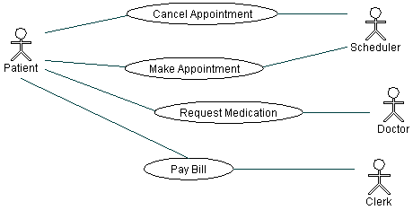
Multiple Actors
We've put Make Appointment as part of a diagram with four actors and four use cases.
Notice that a single use case can have multiple actors.

Slide 15
Associations
Associations between actors and use cases are indicated in use case diagrams by solid lines. An association exists whenever an actor is involved with an interaction described by a use case.
Associations are modeled as lines connecting use cases and actors to one another, with an optional arrowhead on one end of the line.
The arrowhead is often used to indicate the direction of the initial invocation of the relationship or to indicate the primary actor within the use case.

Slide 16
System boundary boxes (optional).
You can draw a rectangle around the use cases, called the system boundary box, to indicates the scope of your system.
Anything within the box represents functionality that is in scope and anything outside the box is out of scope.
System boundary boxes are rarely used, although on occasion they are used to identify which use cases will be delivered in each major release of a system.

Slide 17
Packages (optional).
Packages are UML constructs that enable you to organize model elements (such as use cases) into groups.
Packages are depicted as file folders and can be used on any of the UML diagrams, including both use case diagrams and class diagrams.
Use packages only when diagrams become unwieldy, which generally implies they cannot be printed on a single page, to organize a large diagram into smaller ones.

Slide 18
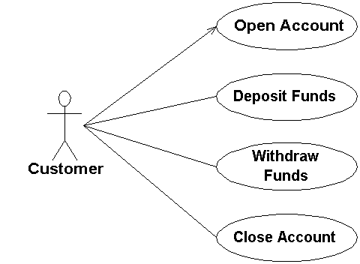
Implying timing considerations between use cases.

Slide 19
Actors
An actor is a person, organization, or external system that plays a role in one or more interactions with your system
Actors are typically drawn as stick figures on UML Use Case diagrams.

Slide 20
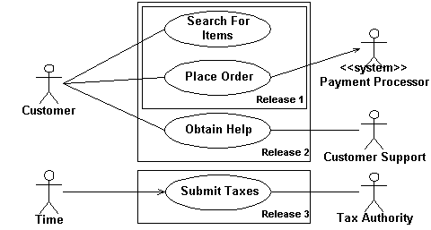
Online shopping

Slide 21
Actor Steps
Place Your Primary Actor(S) In The Top-Left Corner Of The Diagram
Draw Actors To The Outside Of A Use Case Diagram
Name Actors With Singular, Business-Relevant Nouns
Associate Each Actor With One Or More Use Cases
Use <<system>> to Indicate System Actors
Actors Don’t Interact With One Another
Introduce an Actor Called “Time” to Initiate Scheduled Events

Slide 22
Relationships
There are several types of relationships that may appear on a use case diagram:
An association between an actor and a use case
An association between two use cases
Associations are depicted as lines connecting two modeling elements with an optional open-headed arrowhead on one end of the line indicating the direction of the initial invocation of the relationship.

Slide 23
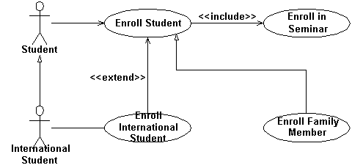
Enrolling students in a university.

